Slide 1
A Tool for Trade-off Resolution on Architecture-Centered Software Development
26th International Conference on Software Engineering and Knowledge Engineering
SEKE 2014, Vancouver, Canada
Authors: Italo Silva, Patrick Brito, Baldoino Neto, Evandro Costa and Hemilis Rocha

Slide 2
Contents
1
Introduction
2
Related Work
3
A Process for Managing Trade-offs Amongst Quality Attributes
4
A Tool for Supporting the Proposed Process
5
Conclusion and Future Work

Slide 3
Introduction
The success of a software project is strongly related with architectural design;
Designing the right Software Architecture is a very subjective task;
Influenced by :
Architect's experience
Quality of requirements engineering.

Slide 4
Introduction
Problems emerge during the architectural design when ..
During the requirements engineering phase
Trade-offs amongst quality attributes have not been identified;
Trade-offs have not been properly managed

Slide 5
Introduction
Objective
Present a Trade-off resolution process to help on hard task of :
Specifying the System Quality Requirements
Trade-offs Detection
Trade-offs Resolution

Slide 6
Related Work
Tropos and i*
Treat quality attributes as soft goals,
Reason about the partial satisfaction of such goals
Elahi and
Yu
A semi-automated tool that uses Even Swaps process
García-Mireles et al.
A conceptual framework
for dealing with software quality trade-offs
The proposed tool can be seen as a tool-supported instance of
such conceptual framework.
the subjectivity of classification and evaluation could produce conﬂicting quality requirements
It Doesn’t focus on managing trade-off involving only software quality attributes.
Managing trade-offs based on a systematic comparison of CMMI and ISO-12207 specifications
Decision making related to conflicting requirements

Slide 7
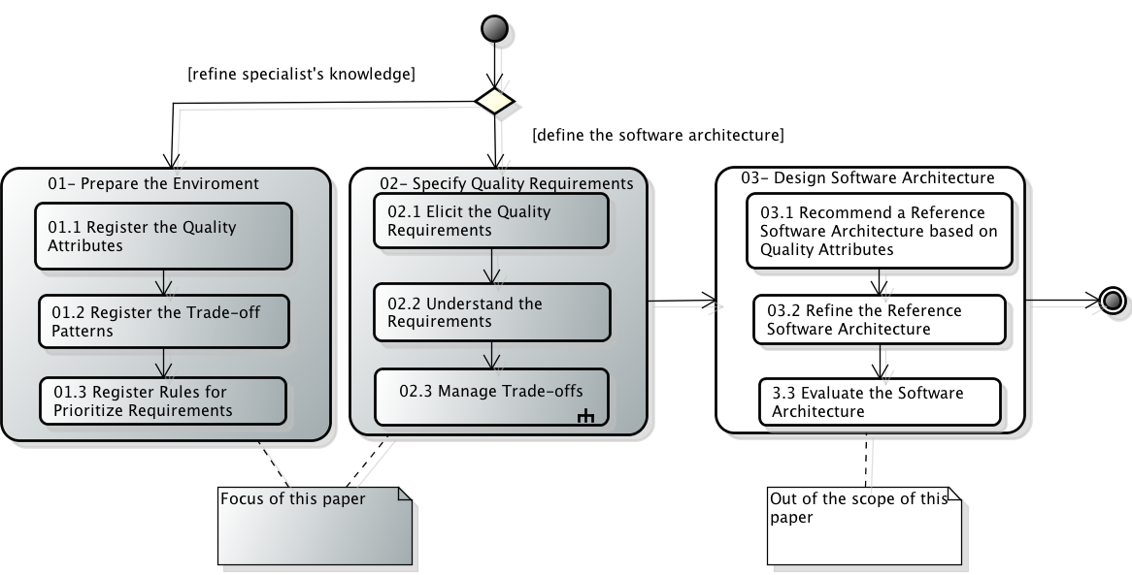
A Process for Managing Trade-offs Among Quality Attributes

Slide 8
A Process for Managing Trade-offs Among Quality Attributes
Each registered trade-oﬀ scenario should be
associated to at least one question
The impact can increase or decrease the weight of the quality attribute
Each Question has an impact associated to its answer

Slide 9
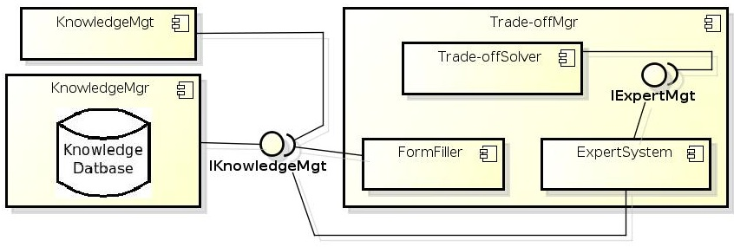
A Tool For Supporting The Proposed Process
Use the ExpertSystem component to reason about the trade-offs
passing the stakeholder’s answers regarding quality attributes to ExpertSystem
A rule-base system that Emulates the decision-making ability of a human expert

Slide 10
Conclusion and Future Work
Conclusion
The proposed solution comprises a systematic process supported by a tool;
Future Work
Evaluation in real scenarios;
Link trade-off resolution of quality attributes to design decisions related to the choice of architectural styles
Supporting the architectural design by recommending reference architectures
This tool will help young requirements engineers and software architects in the trade-off resolution process;
The tool has a rule-based architecture thus keeping the technical knowledge and experience at the software company.

